Slide 1

Energy Islands
Renewable Energy for Everyone

Slide 2
Problem statement
No Grids:
How to Build a Grid in an environment where there is no Grid at all
Team Energy Islands:
Thulasi Krishna
Rythima Shinde
Alexander Klauer
Qianchen Yu
Manuela Krull-Mancinelli

Slide 3

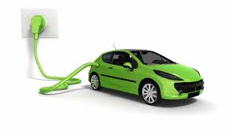
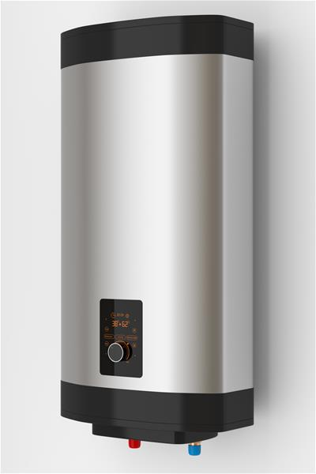
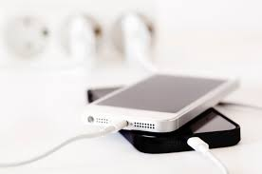

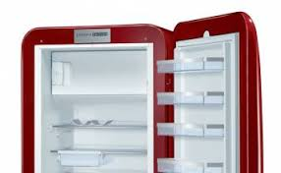
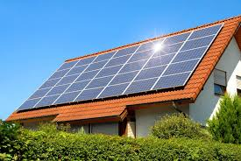
Energy Island
TRADING LEVEL:
Energy trading between devices
Solution for areas where there is no grid at all
Not most efficient set up from energy pov

Slide 4
Resilient Grid
TRADING LEVEL
Energy trading between Energy Islands
Solution for areas with or without a public grid
More efficient level from energy pov

Slide 5
Opportunities
Business
Opportunity to develop business for the ‘Plugin’ and (smart) battery readers
Consumer
Quick set up of energy supply,
Revenue opportunities using unused storage and unused space (see also other energy teams)
Governance
Opportunity to redesign energy regulations

Slide 6

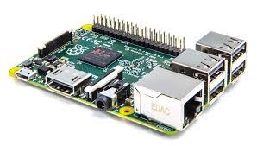


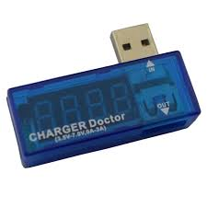


How does it work
Plug In Device
Rapsberry Pi
Ethereum network
kwh
Deal
kwh
kwh
Predictive Model
Devices with Battery
Energy Measurements
Matching Logic
Register Deals & Payments

Slide 7

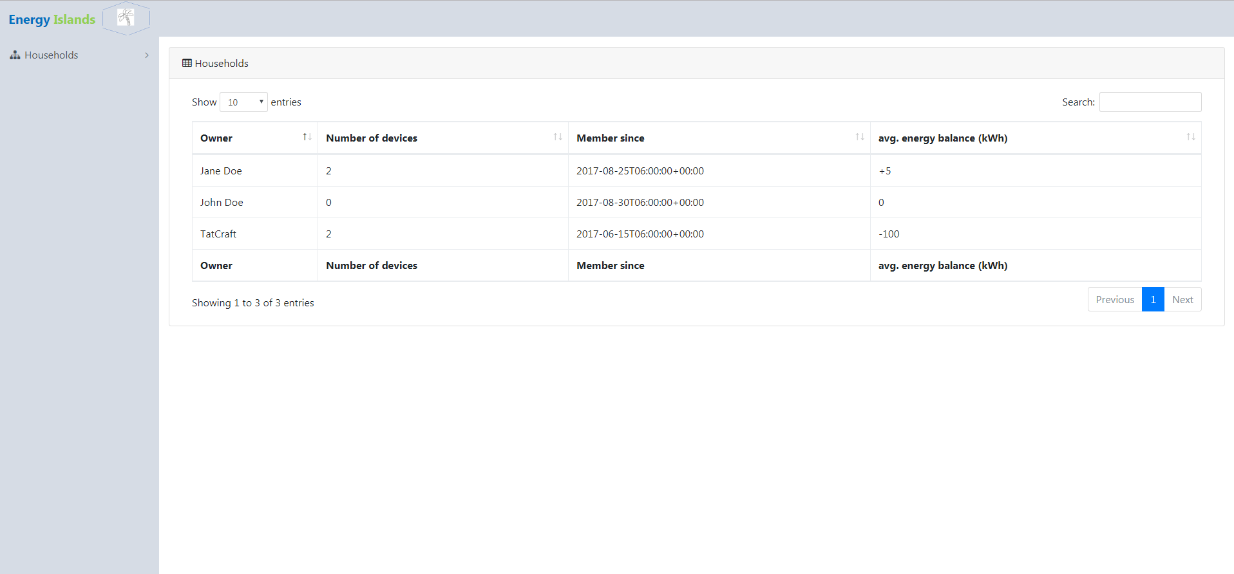
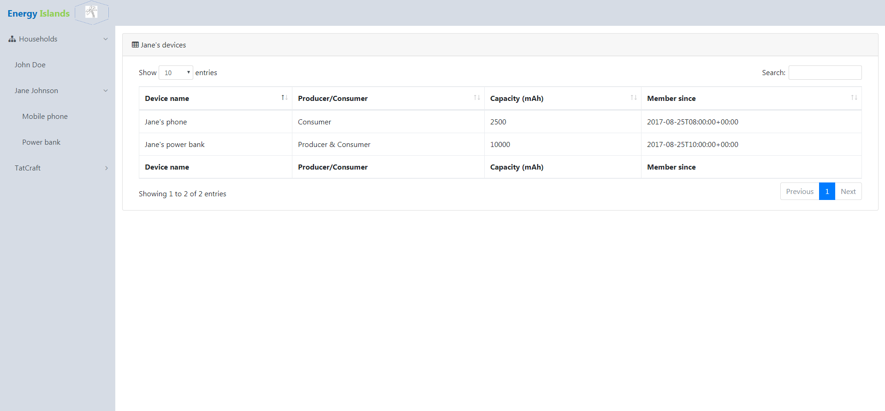
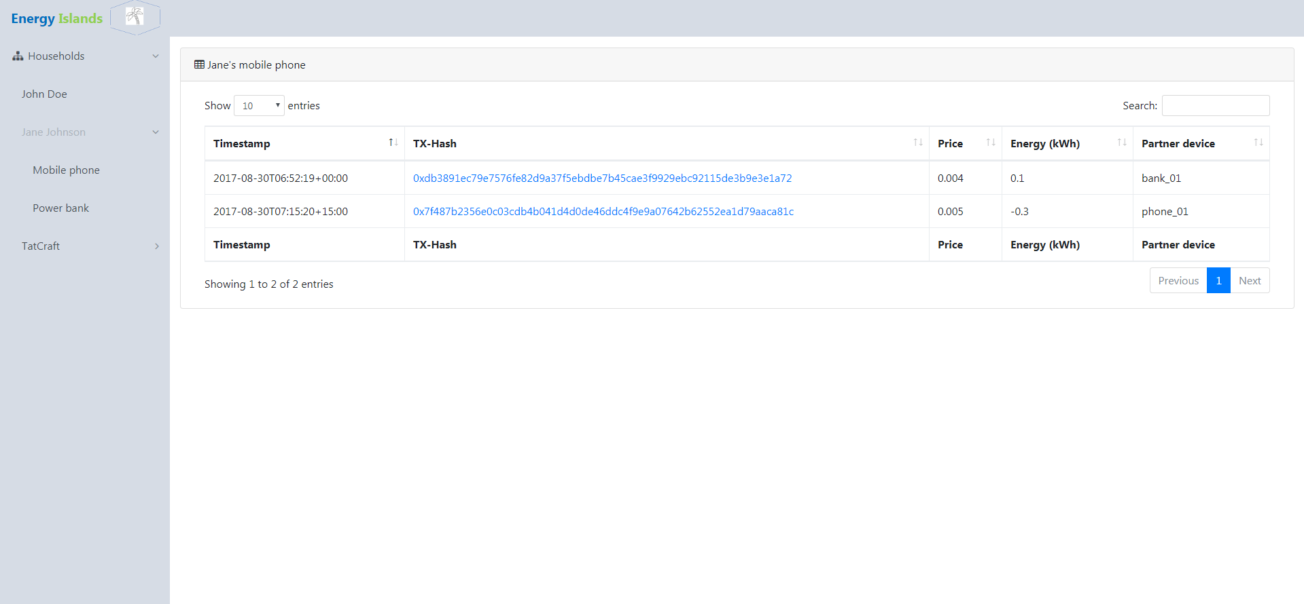
Consumer View
Trade preferences
Preferences
Raspbery Pi
Ethereum network
HouseHold
Devices
Transactions
Deal
Predictive Model
Consumer Interface
Devices with Battery
Energy Measurements
Matching Logic
Register Deals & Payments

Slide 8
Enhancements – connecting to other projects
Existing Grids:
How to Reduce Grid load & Proliferate Renewables
Certification
How to verify Renewable Energy
No Grids:
How to Build a Grid in an environment where there is no Grid at all

Slide 9
Demo

